Slide 1
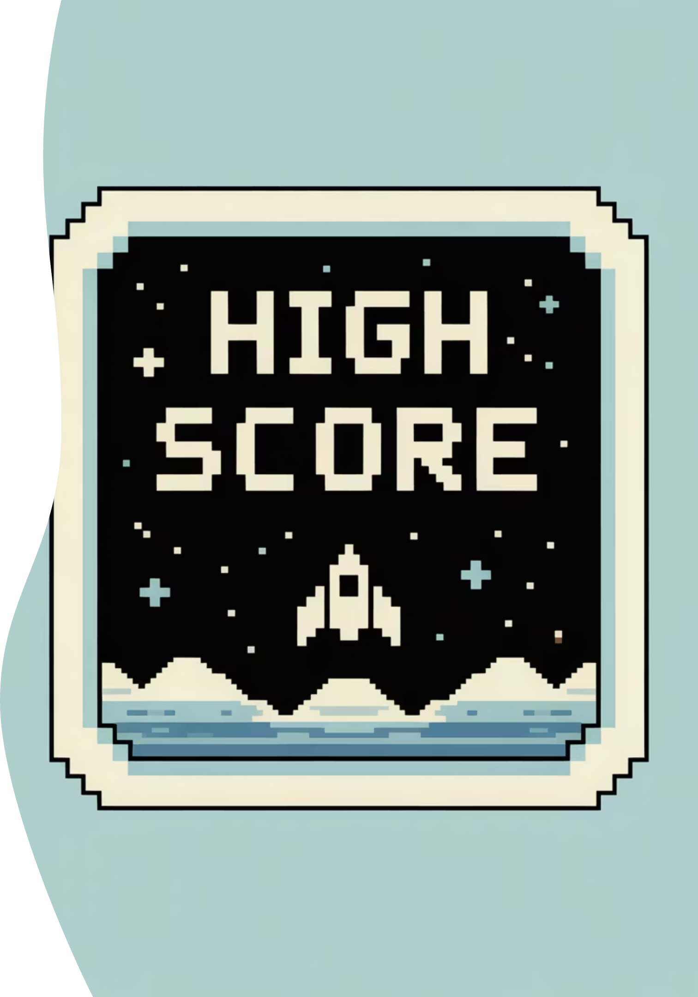
Level-Up Your Daily-Routine
“Play is the highest form of research” – Albert Einstein

Slide 2

The Problem
Current tools are powerful but joyless teams need engagement, not just efficiency

Slide 3
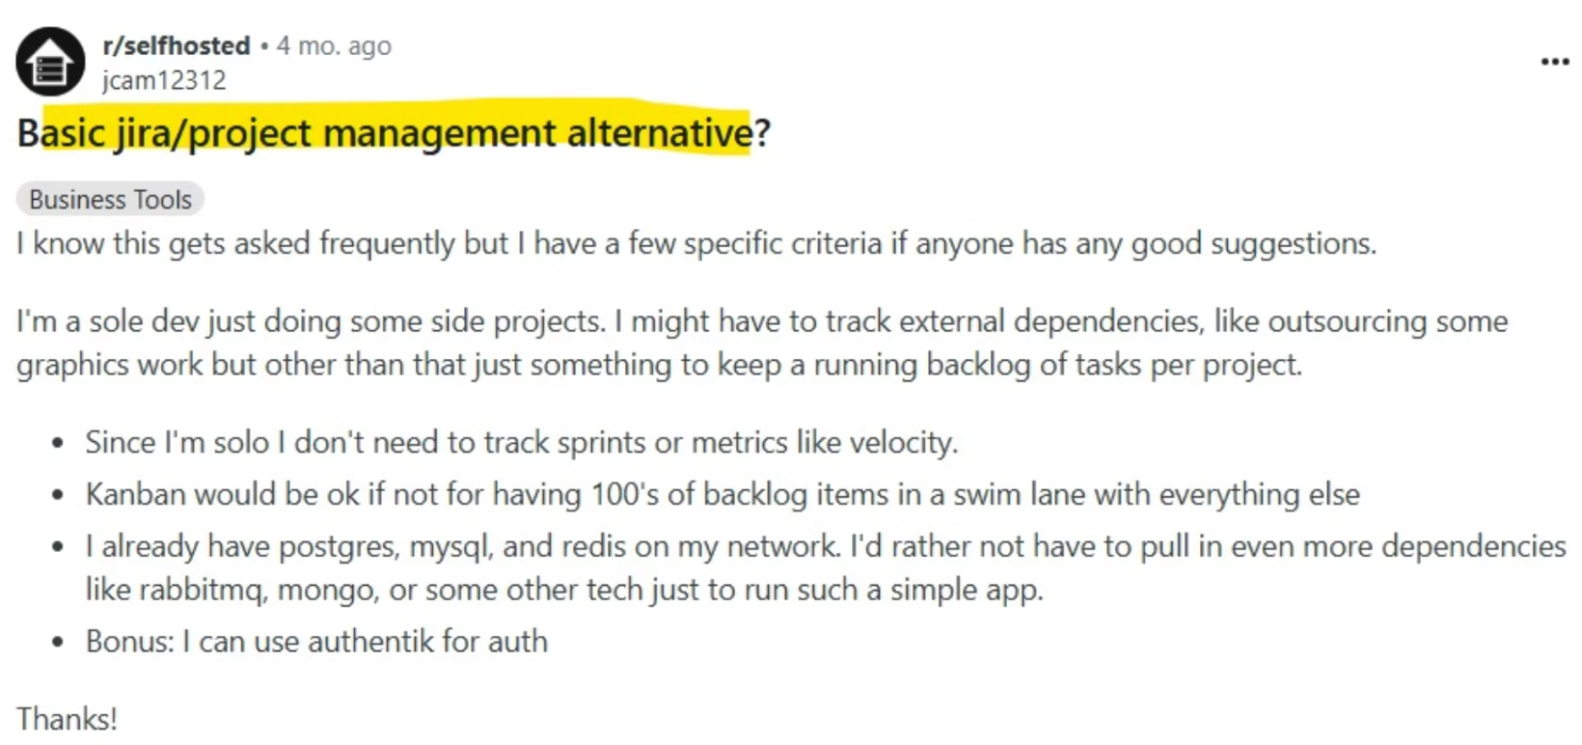
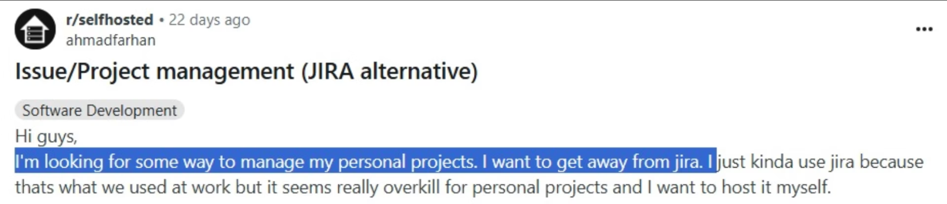
What Teams Really Want
Real feedback from teams struggling with current solutions

Slide 4
Competitive Landscape
Jira
Asana
Powerful but heavy industry standard lacks fun factor
Strong visuals but corporate feel limits engagement
Monday.com
ClickUp
Team-friendly but serious interface misses playful opportunity
Feature-rich but overwhelming complexity kills adoption

Slide 5
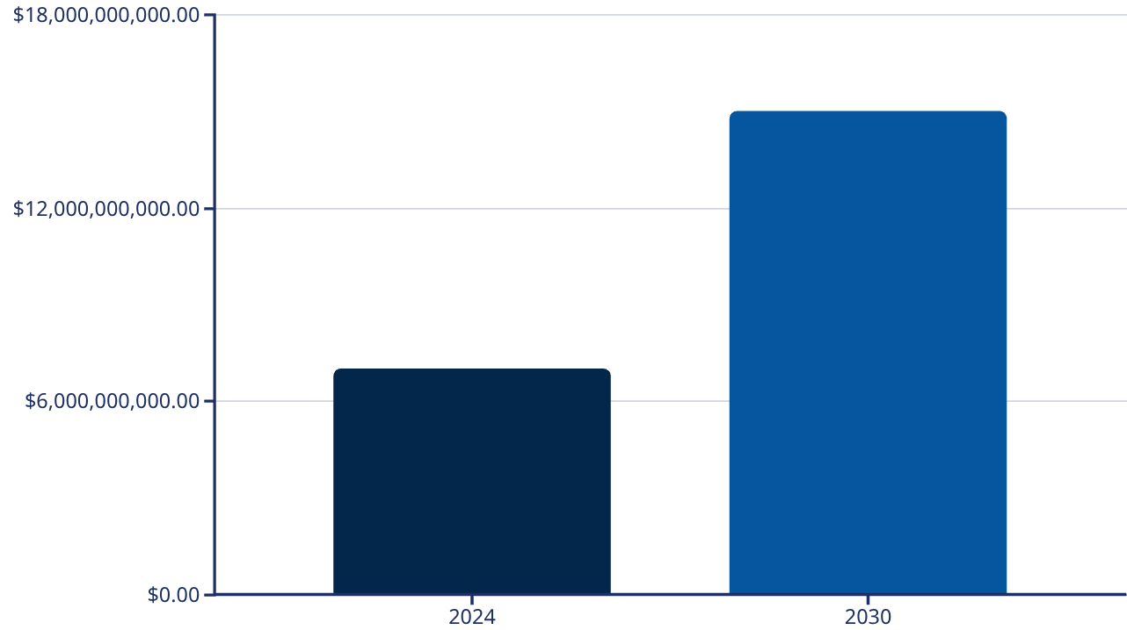
Market Opportunity
Project Management Software
10-12% CAGR growth expected through 2030
Gamified productivity tools trending as companies prioritize engagement

Slide 6
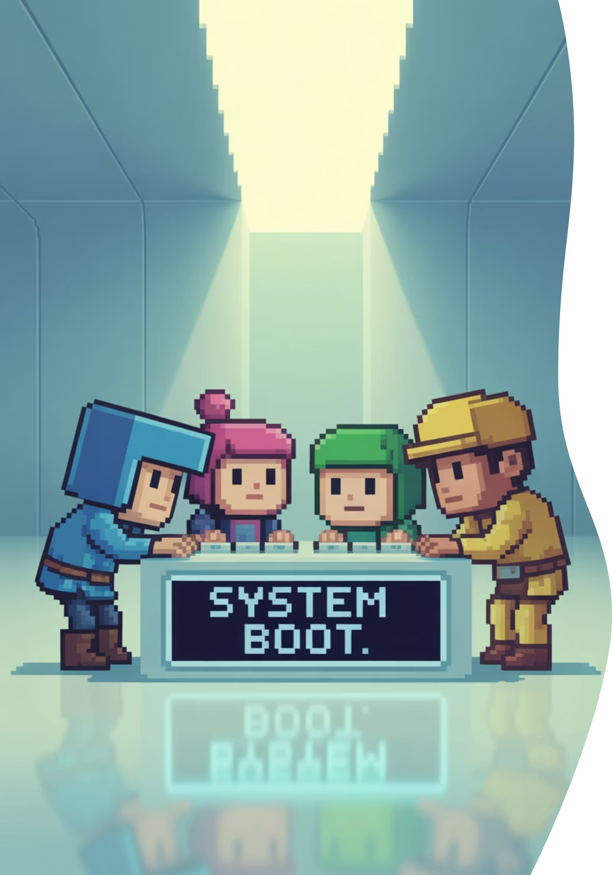
Our Unique Approach
Retro Arcade Design
Smart Gamification
Playful interface makes task management engaging
Points, levels, and badges motivate completion
Culture Booster
Shared game experience builds team connection

Slide 7




Core Features
Task Management
XP & Leaderboards
Full project workflow—assignment, tracking, completion with arcade flair
Team competition drives engagement through points and achievements
Boss Fights
Smart Integrations
Major milestones become epic team challenges to conquer together
Seamless workflow with Slack, Google Workspace, and GitHub

Slide 8
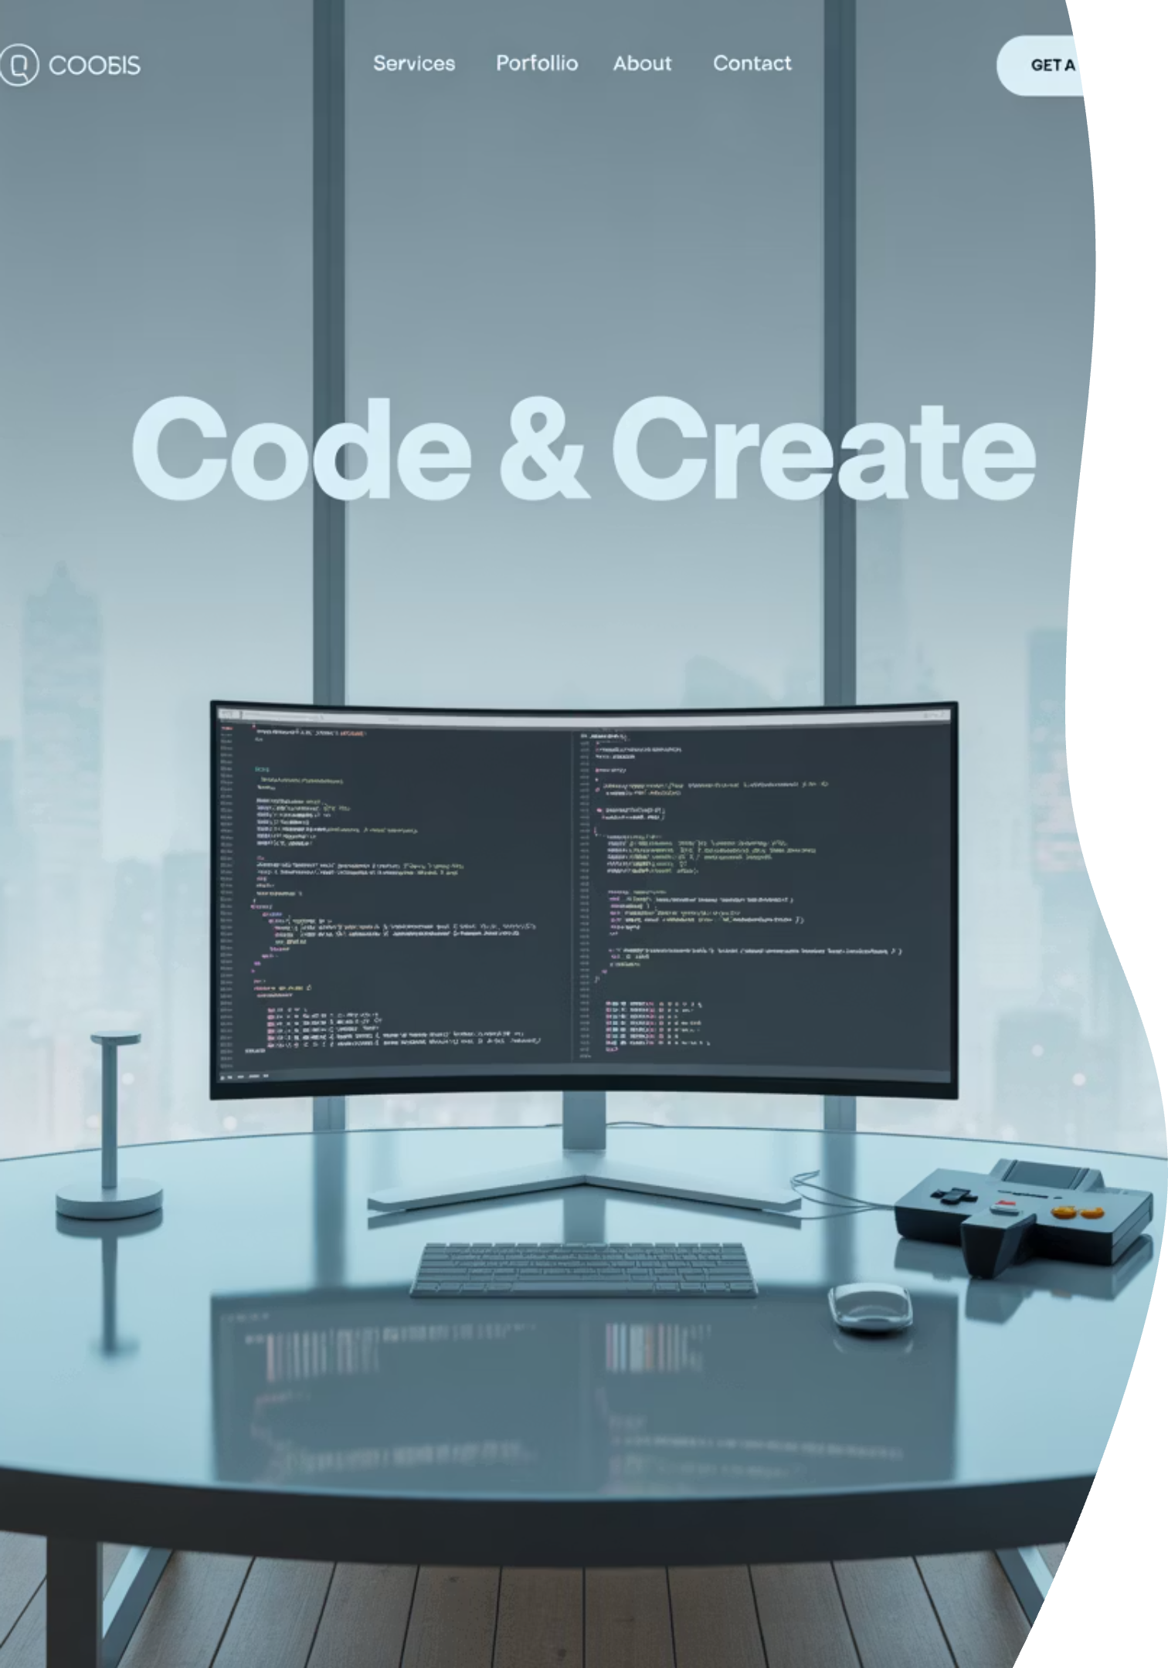



Technology Stack
Frontend Magic
React + Pixel-perfect retro UI themes
Robust Backend
Node.js/Python with PostgreSQL + Redis caching
Cloud Infrastructure
AWS/Google Cloud for reliable, scalable hosting

Slide 9








Target Customers
Tech Startups
Creative Agencies
Want Jira structure without corporate overhead
Need organization but prefer engaging tools
Student Teams
Remote Teams
Natural fit for gamified learning environments
Require motivation beyond standard task boards

Slide 10
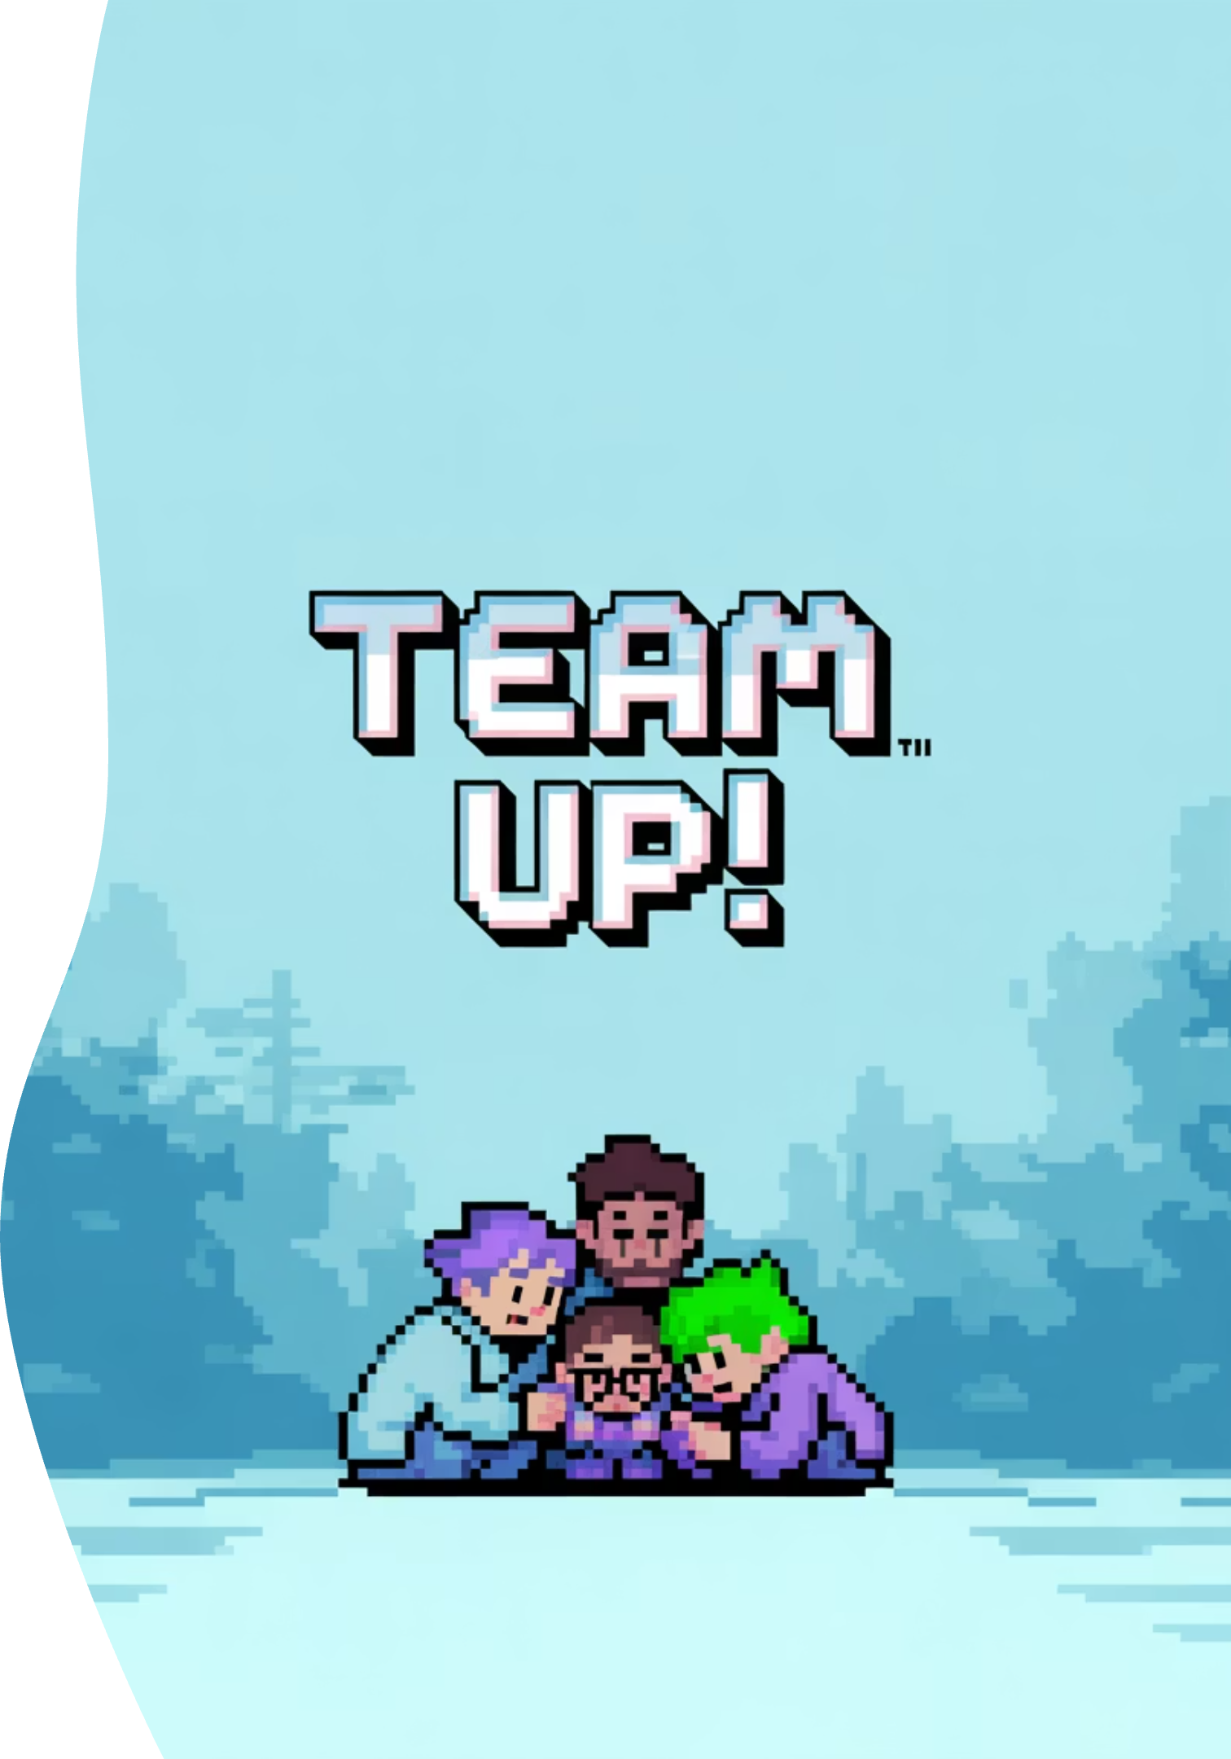
Ready to Play?
Transform your team's productivity into an epic adventure

